Slide 1
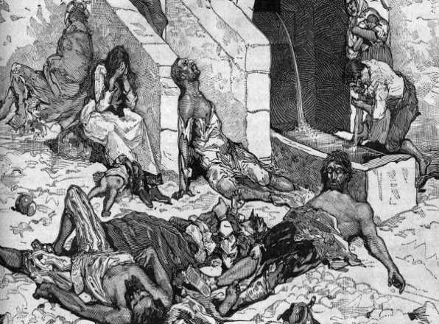

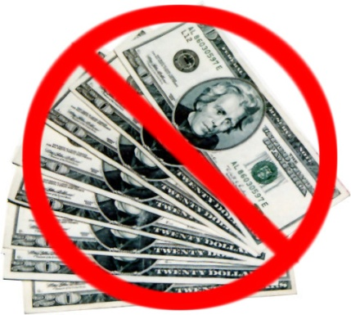

Effects of the Black Death!
-
-
<
-
-

Slide 2
Effects of the Black Death!
-Decline in Population
-Scarcity of Labor
<
- Decline of Church influence
- Freed from feudalism and disrupted traded

Slide 3
Black Death (Bubonic Plague) Card Game
Roles:
Serfs/peasants are farmers and always have to worry about food. You should focus on collecting clubs (food). You are the majority of the population, thus you will be fighting over scarce resources
Merchants are traders and should focus on collecting diamonds (money).
Nobles are the wealthy and are concerned with their status or reputation. You should focus on collecting spades.

Slide 4




Black Death (Bubonic Plague) Card Game
Each player will receive 1 role card and 7 playing cards
Jokers—represent infection with the Black Death
--represent happiness and well-being and health. All players benefit from these cards
--represent honor and status. These cards are needed for nobles.
--represent wealth. These cards are needed for merchants.
--represent food. These cards are especially needed for serfs.

Slide 5
Black Death (Bubonic Plague) Card Game
We will play 4 rounds, each round lasting 2 minutes
During each round you can trade (or not trade) as many cards as you would like with the other players; however, if at the end of the round you have a joker you are dead and out of the game
You may not show the other players your cards while trading, you trade on “good faith”
Your cards will then be re-distributed to those closest to you, including the Jokers!
For every 3 cards you need (determined by your role) you will receive 10 points, all are scored at face value

Slide 6
Black Death Card Game Reflections:
Which social class was most affected by the Bubonic Plague? Explain your answer (why and how was this class most affected?).
At the end of each round those with Jokers died and their cards were re-distributed to those nearest the deceased. How is this represented of the spreading of the plague during the 14th Century?
During the years of the Black Death trading was disrupted how is this exemplified in the game?

Slide 7
Bubonic Plague Exit Slip:
In 3-5 sentences explain how the Bubonic Plague caused a decrease in the power and influence of the Church.
In 3-5 sentences explain the effect the plague had on Medieval and Feudal society. (What problems did it create? What cultural, political, and economic changes did it create?)

